Slide 1
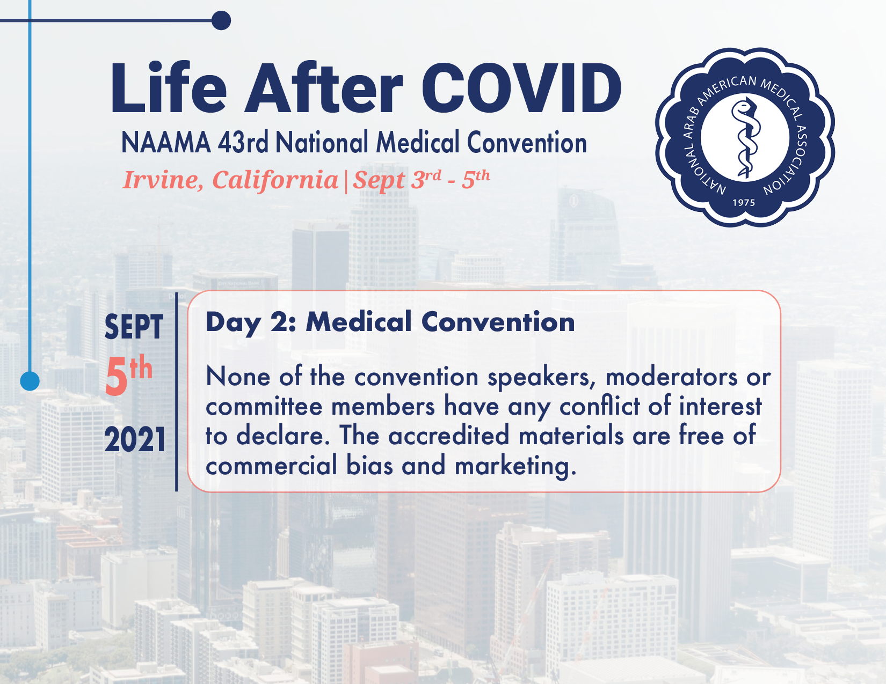

Slide 2
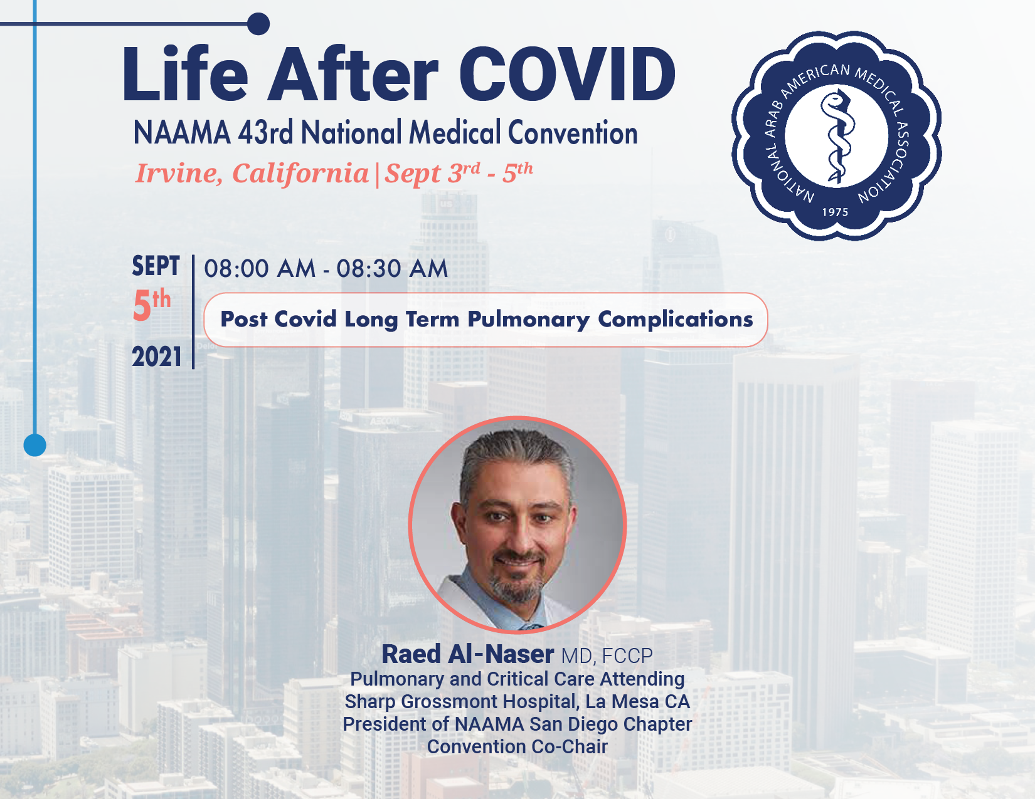

Slide 3

Post COVID-19 Long Term
Pulmonary Complications
Raed Al-Naser MD, FCCP
NAAMA 43RD NATIONAL MEDICAL CONVENTION
LIFE AFTER COVID
SEP 3 - 5, IRVINE CALIFORNIA

Slide 4

What will we cover today?
COVID-19 is primarily respiratory disease!!!
COVID-19 and the symptoms
Respiratory symptoms in COVID-19
Common mechanisms of pulmonary symptoms in Post COVID-19
Pulmonary management in Post COVID-19
Questions and answers

Slide 5
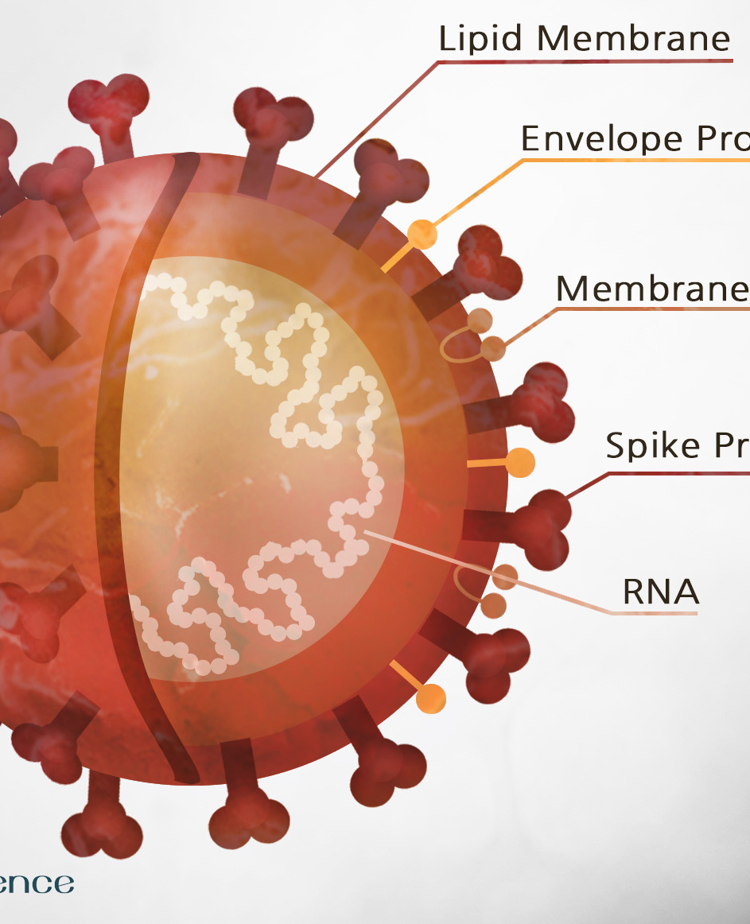
COVID-19
SARS-CoV-2 is a corona virus
It is highly contagious
Corona viruses are common viruses that cause common cold
Previous viruses of concern: SARS-CoV-1 and MERS

Slide 6
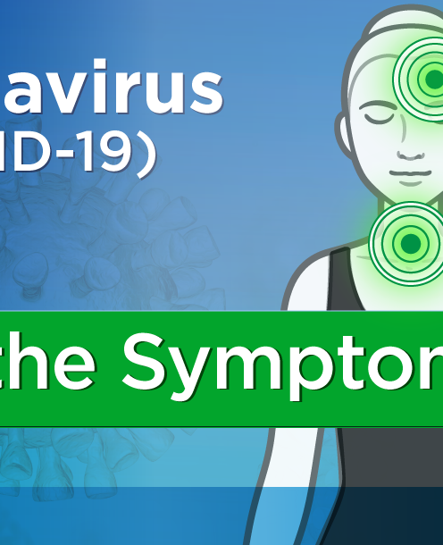
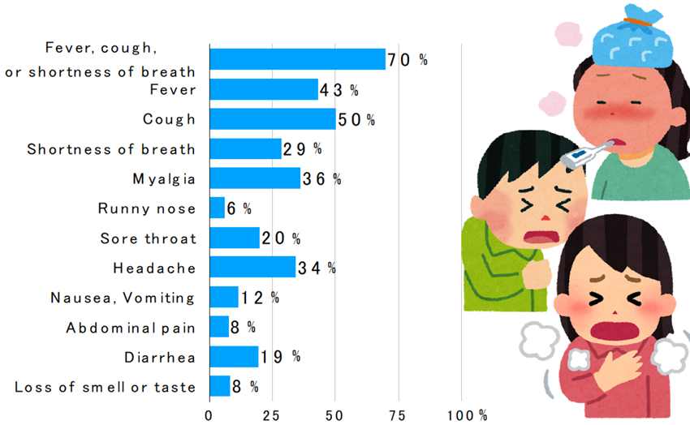
Common COVID-19 Symptoms

Slide 7

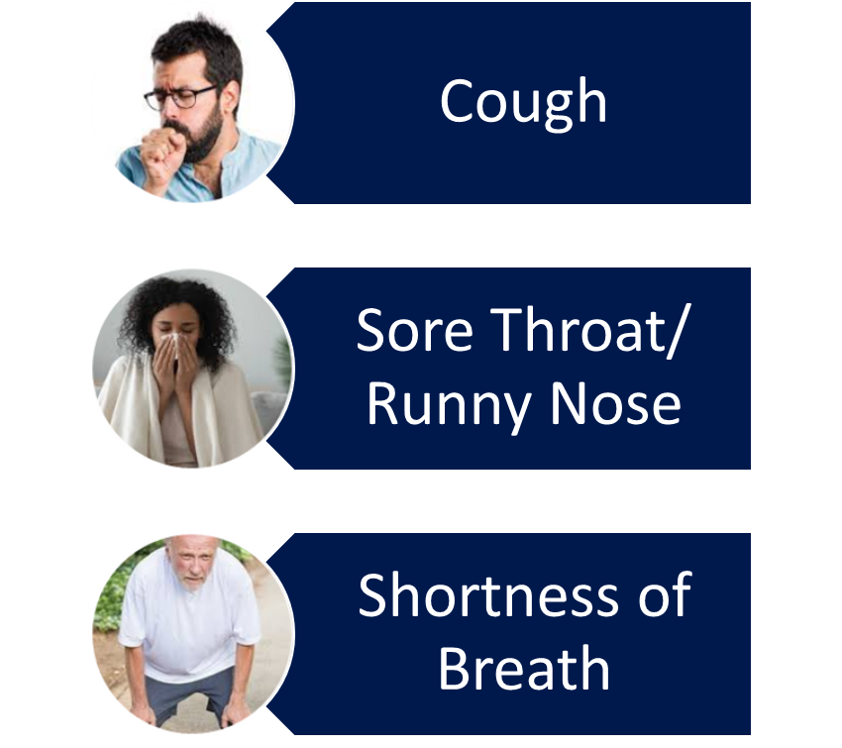
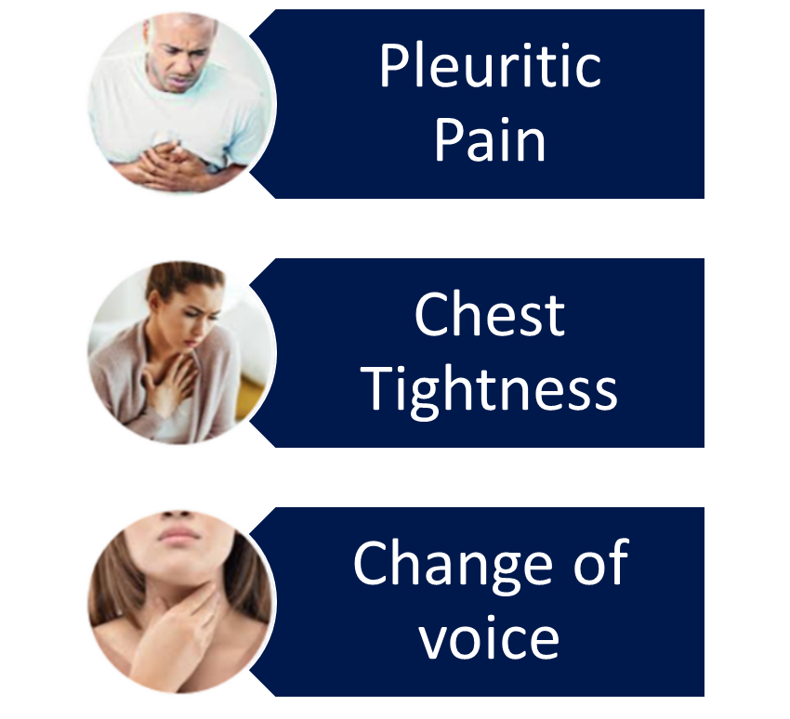
COVID-19 Common Respiratory Symptoms

Slide 8
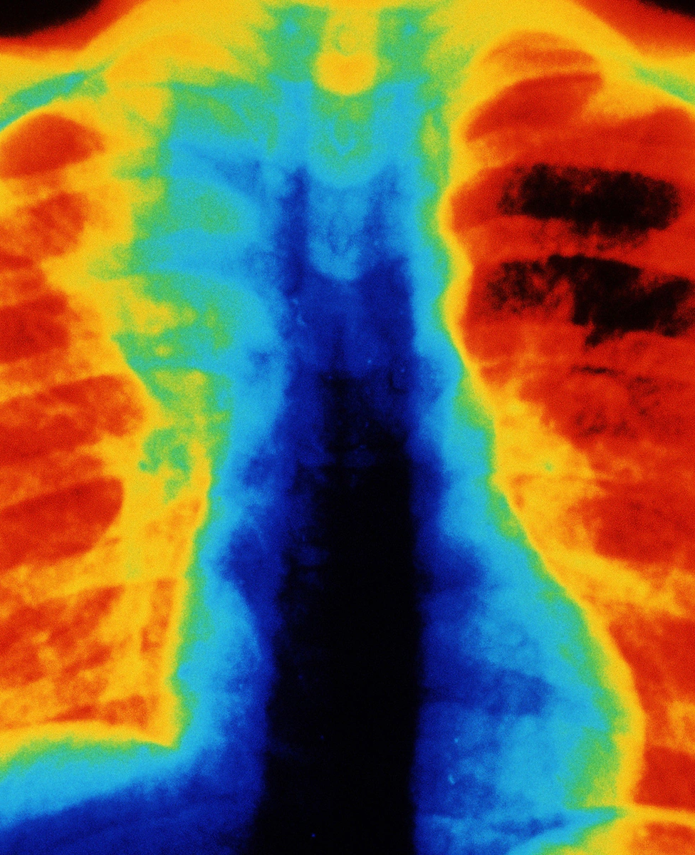
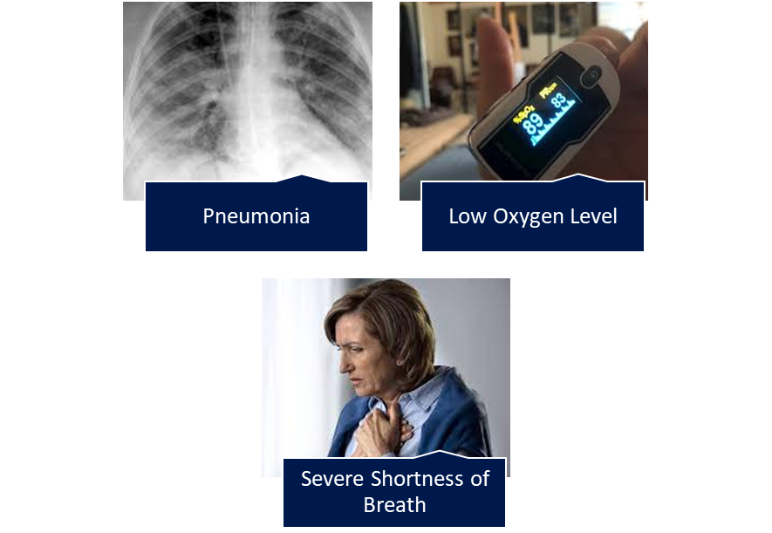
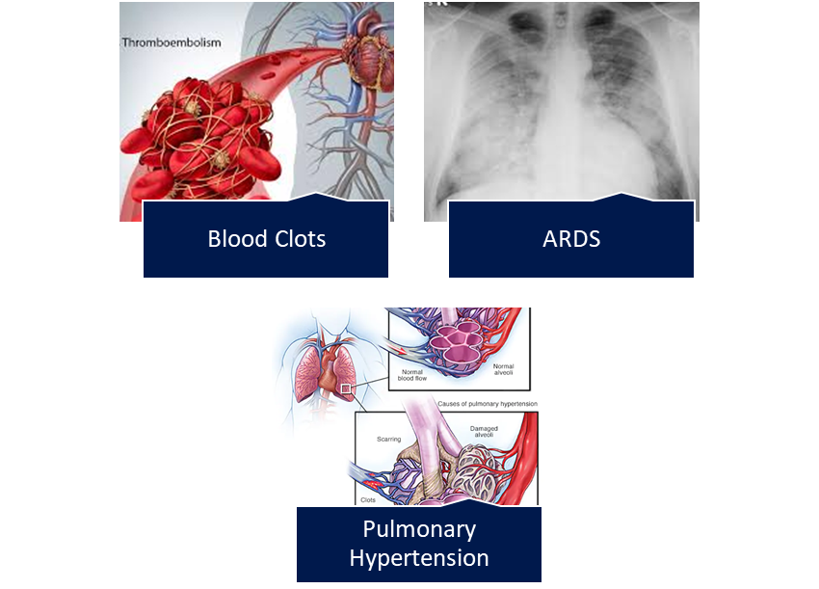
Respiratory Complications in Severe COVID-19

Slide 9
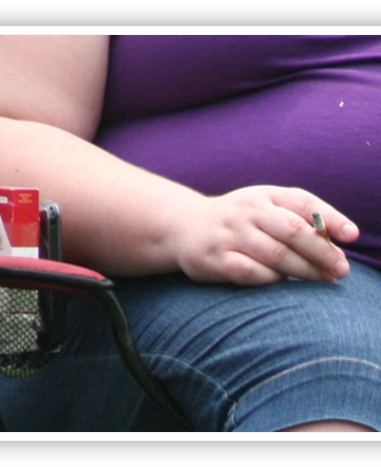
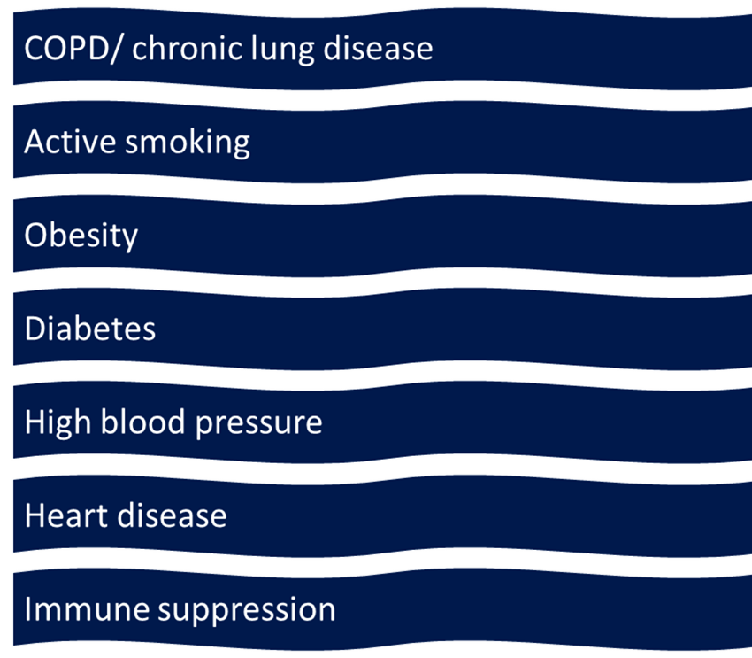
Who is at Risk for Severe Pulmonary Complications

Slide 10
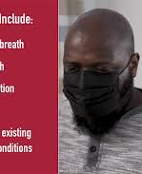
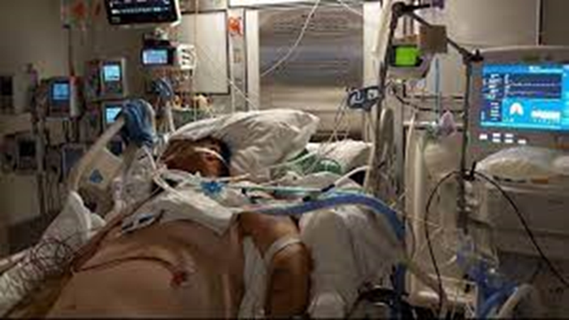
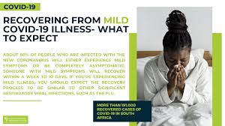
Pulmonary Complications in Post COVID-19
People with severe COVID-19 pulmonary disease may recover without Post COVID-19 Syndrome.
People with mild COVID-19 pulmonary disease may develop Post COVID-19 Syndrome

Slide 11

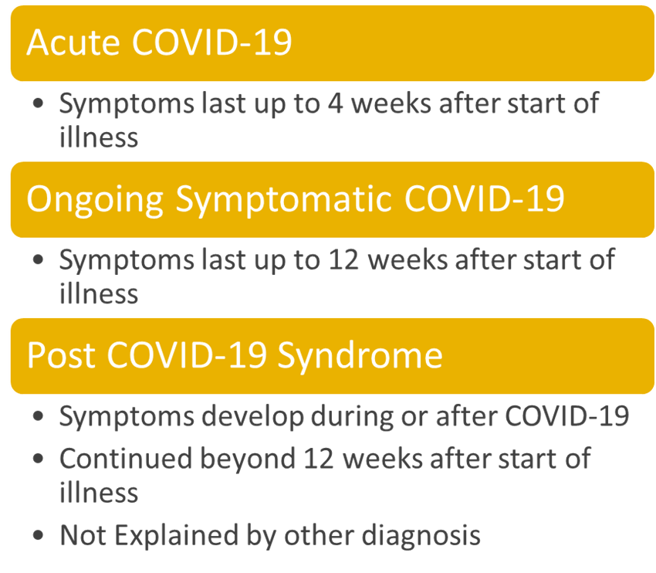
What is “Post COVID Syndrome”?

Slide 12
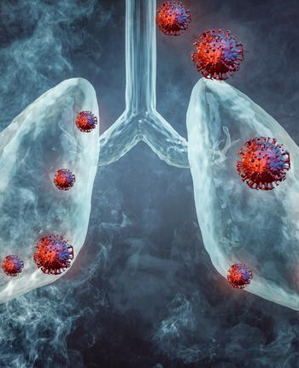
Post COVID-19 Pulmonary Complains
Cough
Shortness of Breath
Wheezing
Chest Tightness
Pleuritic pain

Slide 13
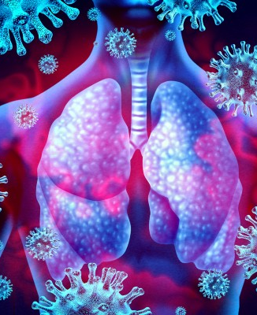
Common Mechanisms of Pulmonary Symptoms in Post COVID-19
Airway inflammation
Lung Tissue Injury
Blood Clots
Deconditioning

Slide 14
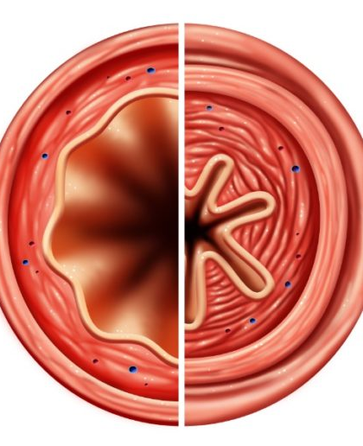
Airway Inflammation
Reactive Airway Disease
It is common after many viral infections
Common symptoms; cough, wheezing and chest tightness
Three groups of patients
* Never had asthma and no risk for asthma
* No asthma but at risk for asthma
* Known asthma with worsening symptoms

Slide 15
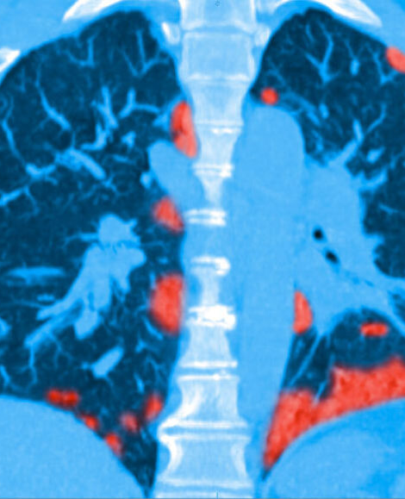
Lung Tissue Injury
Sequalae of Severe ARDS
Common in patients with COVID-19 pneumonia
Most of the patients recover with time
Some patients develop permanent scarring
Degree of injury corresponds with amount of oxygen need

Slide 16
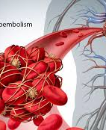
Blood Clots
DVT/PE
Not very common problem
COVID-19 increase the risks of blood clots i.e., DVT/PE in some patients
Large PE associated with low oxygen
It can increase blood pressure within the lungs i.e., pulmonary hypertension

Slide 17
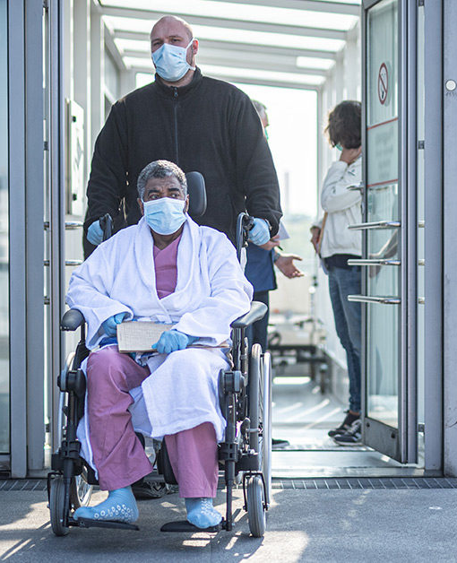
Deconditioning
Myopathy and Neuropathy of Critical Illness
Caused by poor oral intake and weakness
Aggravated by ICU stay, steroid use and ventilator use
COVID-19 related loss of muscle mass
Marked shortness of breath

Slide 18
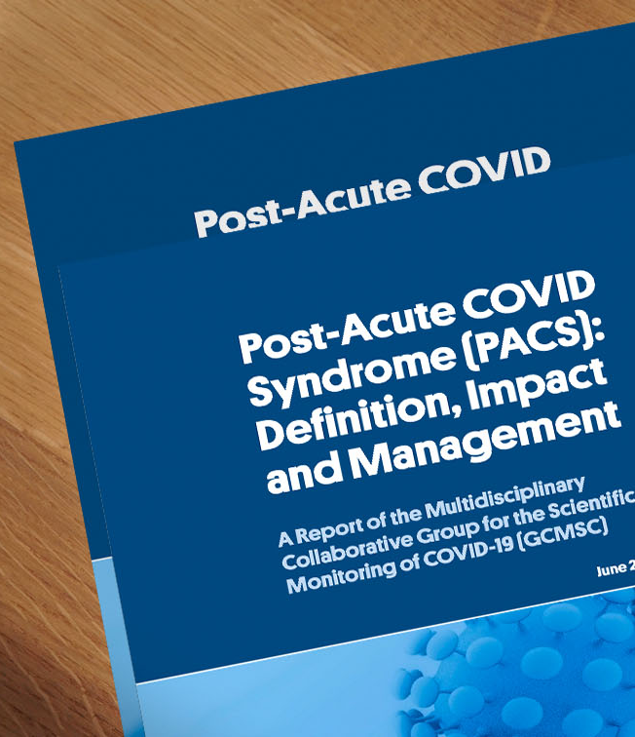
Pulmonary Management in Post COVID-19
Workup and Treatment

Slide 19

Common Pulmonary Work Up
Always start with good H&P
Chest X-ray
Pulmonary Function Test
CT Scan
6-minute walk test
Echocardiogram

Slide 20
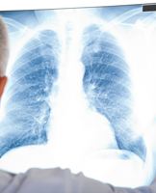
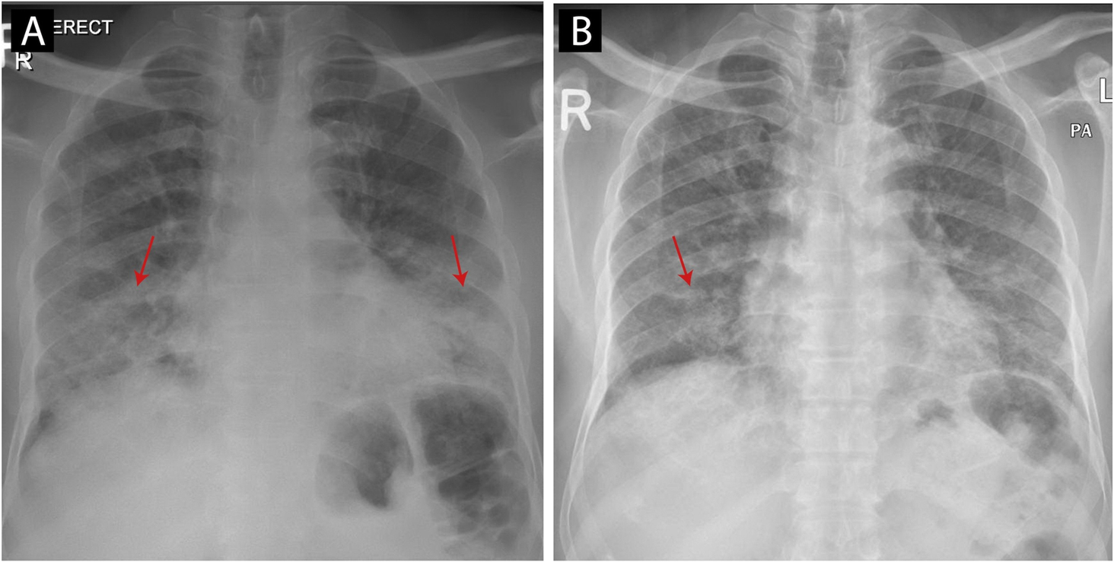
Chest Xray (1a: at the time of COVID-19 infection, discrete areas of airspace consolidation in the bilateral lower and mid zones. 1b: on the second admission, showing resolution of the airspace consolidations in the bilateral lower and mid zones).

Slide 21
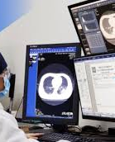
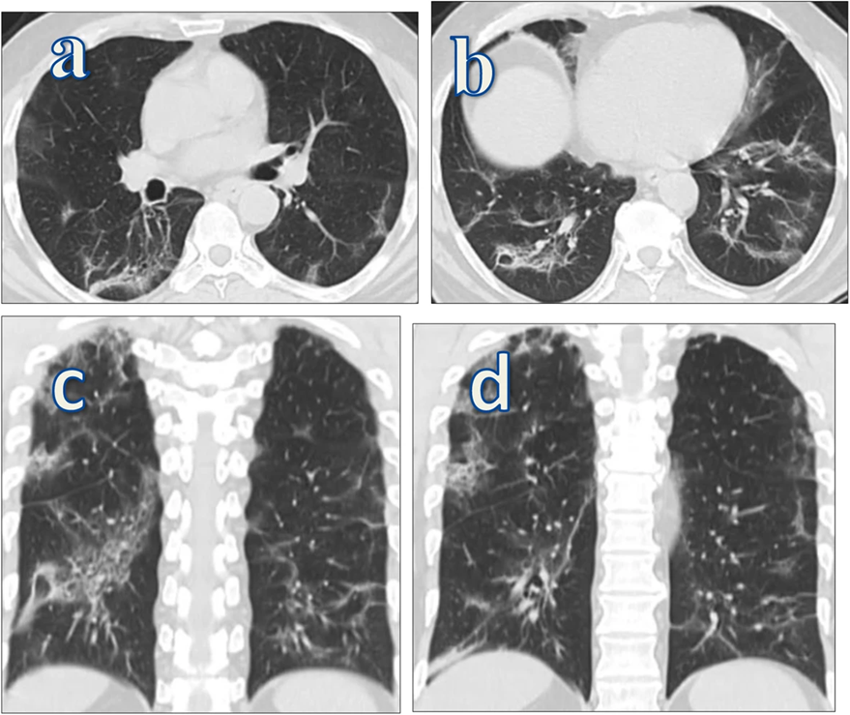
Bilateral pulmonary fibrotic changes in the form of fibrotic bands, peribronchial thickening, traction bronchiectasis

Slide 22
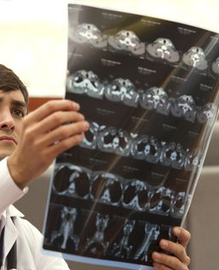
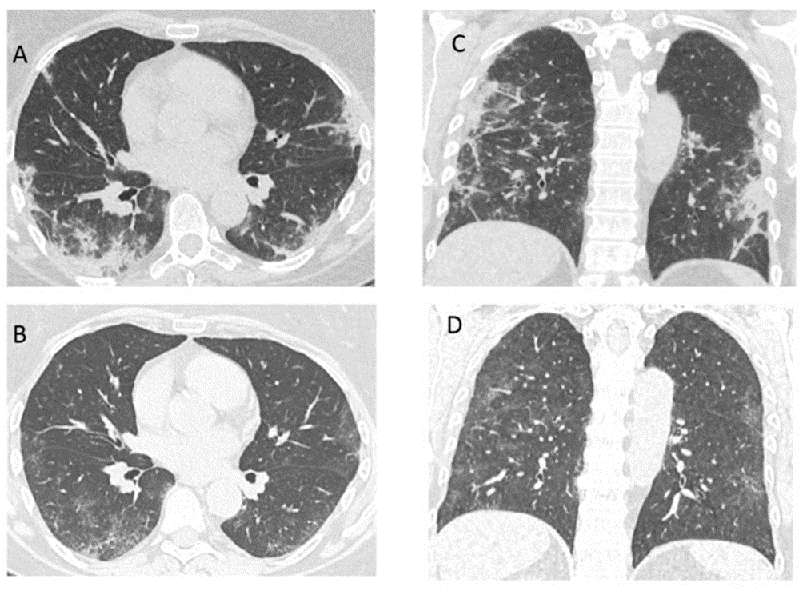
(A,C) Computed tomography (CT) of a 58-year-old woman, 21 days after COVID-19 pneumonia diagnosis, treated at home, with persistent and deteriorating respiratory symptoms. Peripheral consolidation with air bronchograms, reticular changes and small areas of ground glass opacities (organizing pneumonia). (B,D) CT after 4 weeks of treatment with systemic glucocorticoids—resorption of consolidation with the fibrotic component (reticular changes, bronchiectasis).

Slide 23
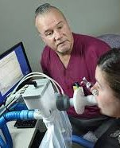
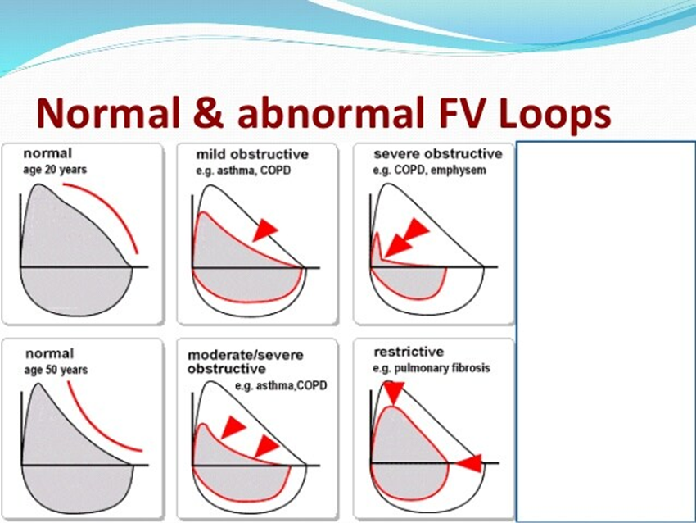
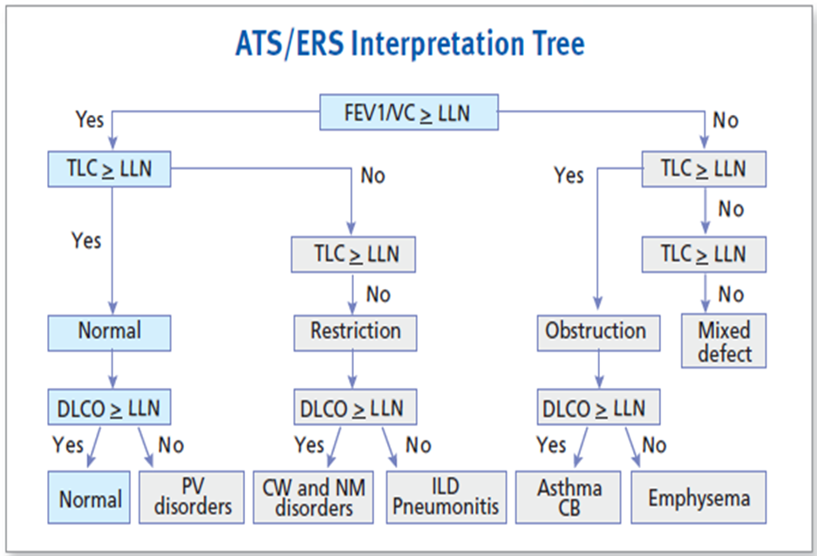
PFT: Spirometry, Lung Volumes and DLCO

Slide 24
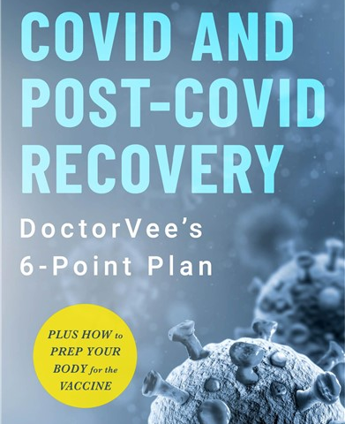
Treatment
Time is the essence
Inhalers and breathing treatments
Oxygen
Oral steroids
Daily exercise
Cardiopulmonary Rehab
Clinical trials

Slide 25

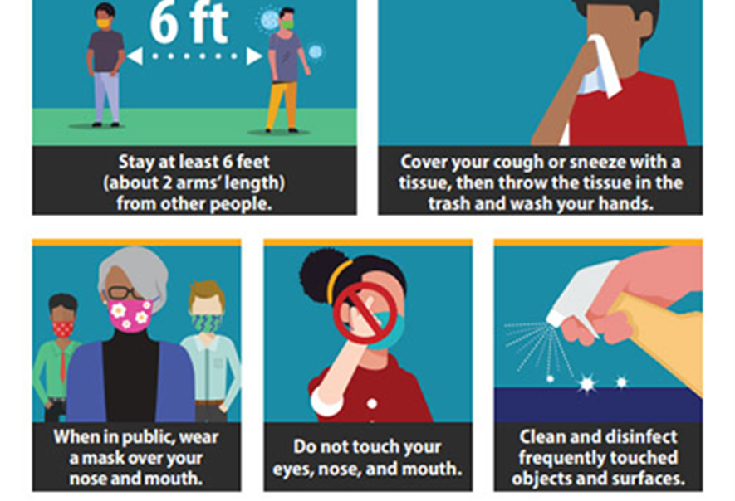
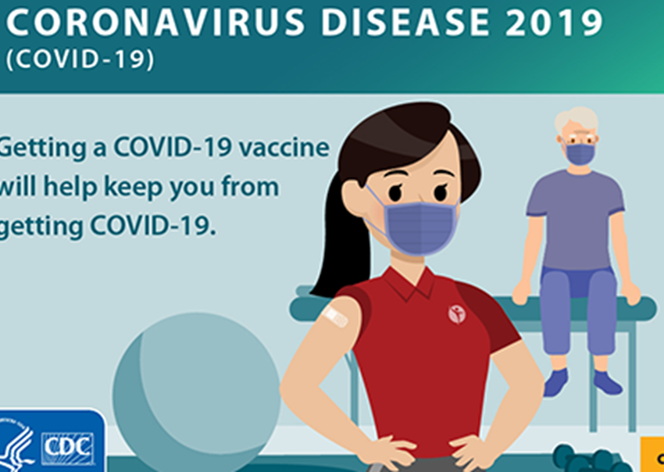
An ounce of prevention is worth a pound of cure.
~Benjamin Franklin

Slide 26

Thank You.
Raed Al-Naser, MD FCCP
619 481 8340
raedalnaser@yahoo.com
www.naamasd.com

Slide 27


Thank you for your attention

